Slide 1
MIDDLETOWN POLICE DEPARTMENT
ANNUAL REPORT
2019

Slide 2
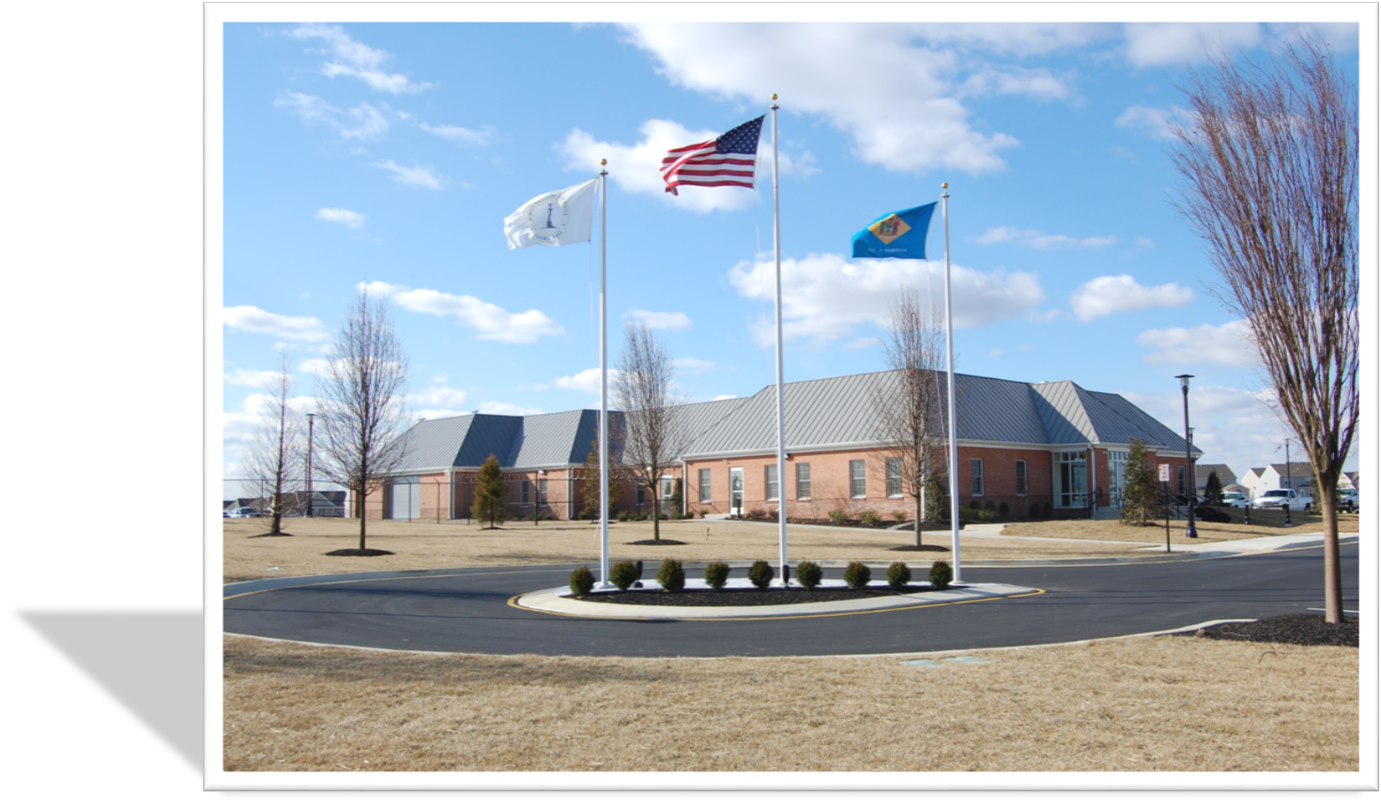
TABLE OF CONTENTS
INTRODUCTION
CHIEF’S MESSAGE
MISSION STATEMEN & CORE VALUES
EXECUTIVE STAFF
PATROL DIVISION
CRIMINAL INVESTIGATIVE DIVISION
COMMUNITY SERVICES
SOCIAL MEDIA
STATISTICS

Slide 3
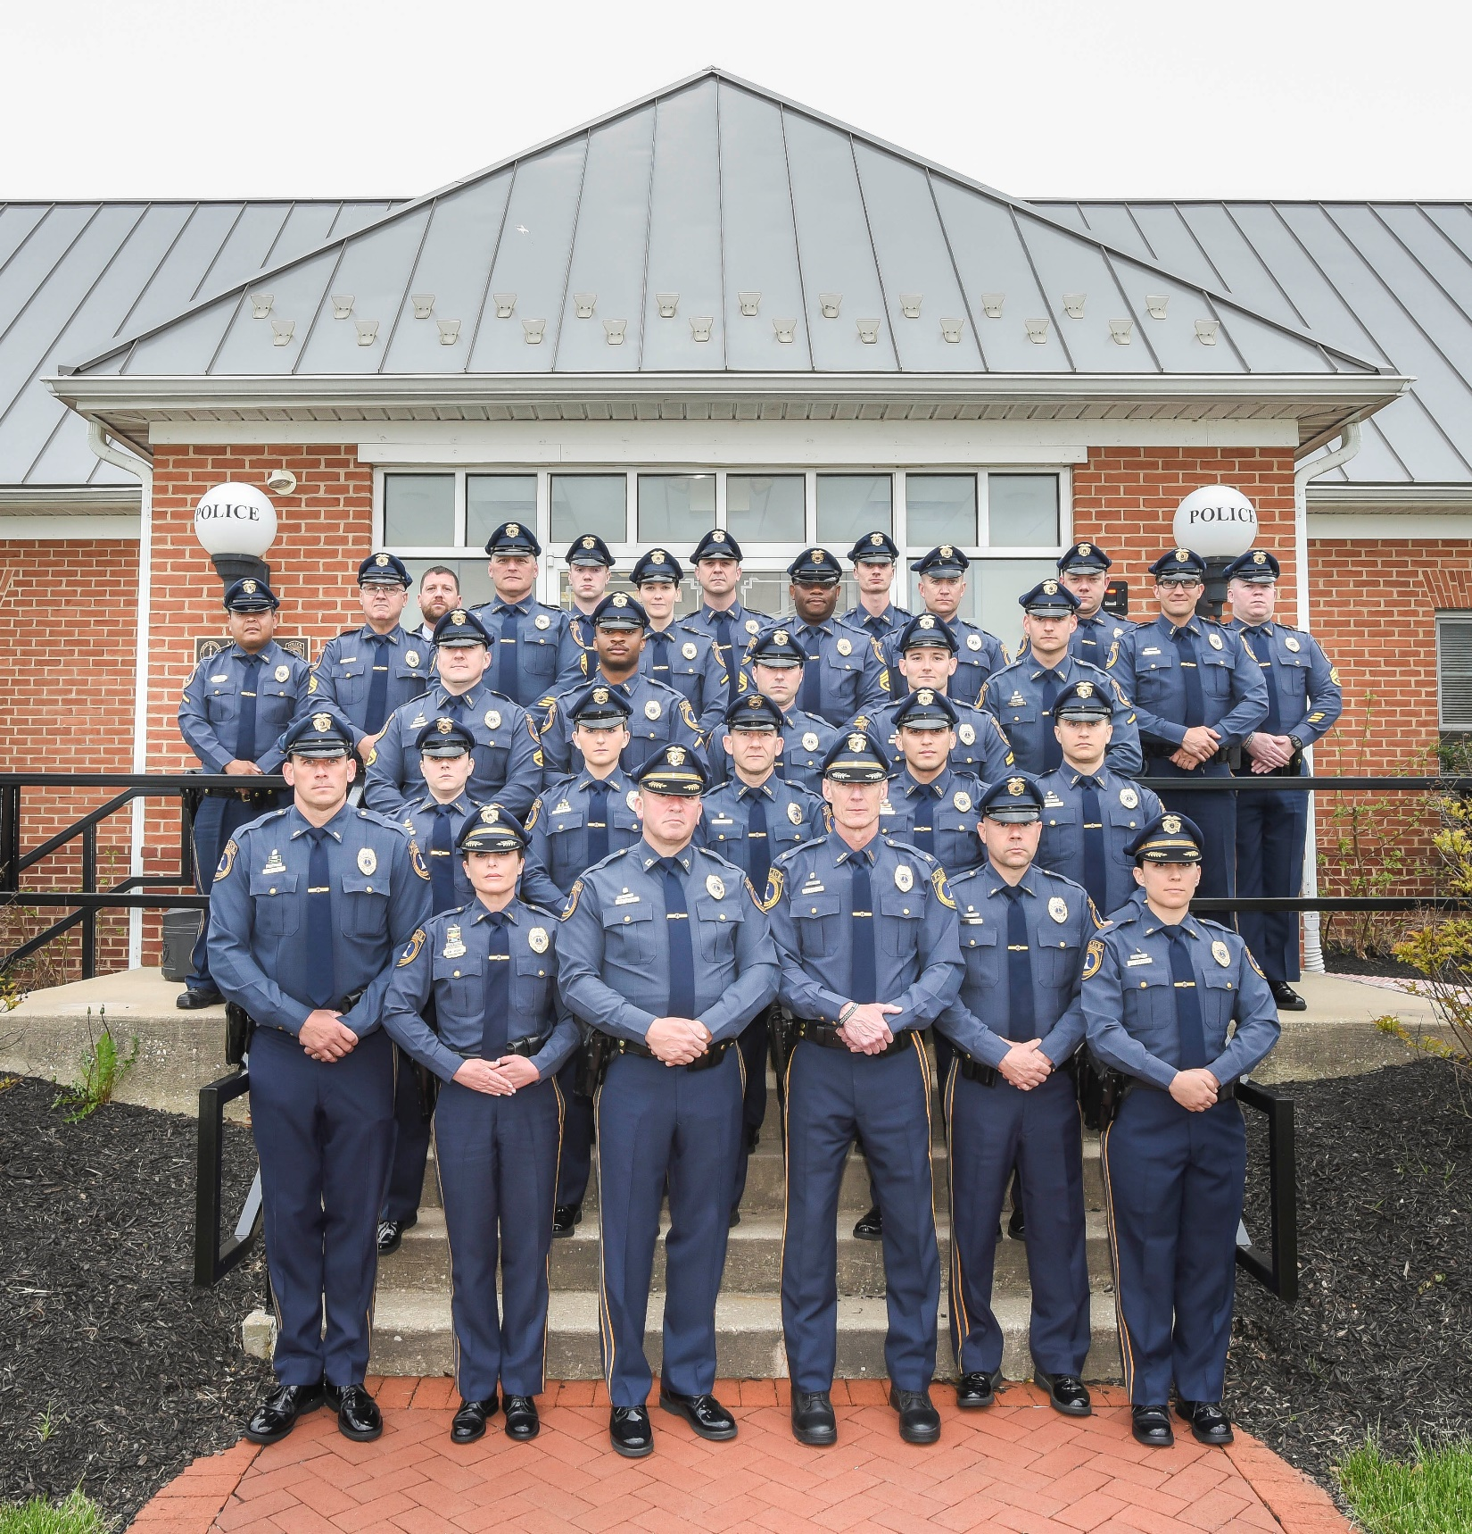
INTRODUCTION
The annual report is designed to provide the Mayor and Council of Middletown along with its Citizens, a perspective of the activities, experiences, and accomplishments of the organization throughout the year of 2019

Slide 4
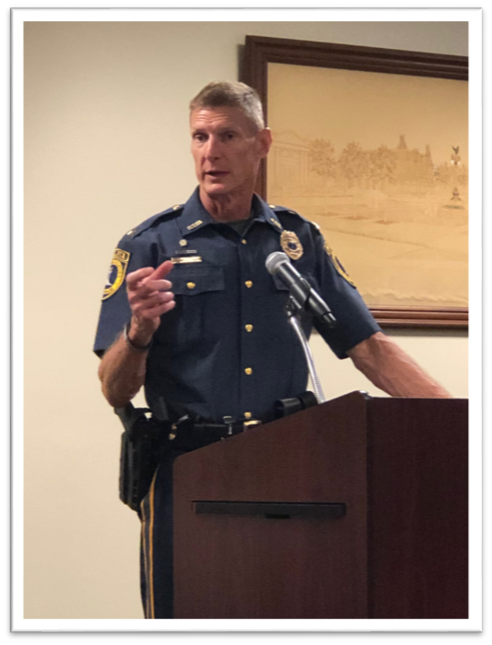
CHIEF’S MESSAGE
The Middletown Police Department was founded in 2007 to meet the growing community of the Town of Middletown. The police force is now nationally accredited and has grown from 20 members to 39 sworn members and 7 civilian support members. The Department is comprised of various units, to include: the Patrol Division, Criminal Investigations, Community Services, Bicycle Patrol, Intelligence Analyst, Mobile Operations, and Administration & Accreditation
We serve over 25,000 residents and have a large business and retail community. We believe in strong community engagement and forging long term partnerships; which is reflected by our mission statement:
“To honorably serve the citizens of Middletown and its visitors using community oriented professional services.”
As a Police Department, we have selected and serve through core values that are fundamental to Law Enforcement Officers:
Integrity - Courage - Accountability - Respect – Empathy
We are all honored to be a part of the Law Enforcement Agency that represents our Community.

Slide 5
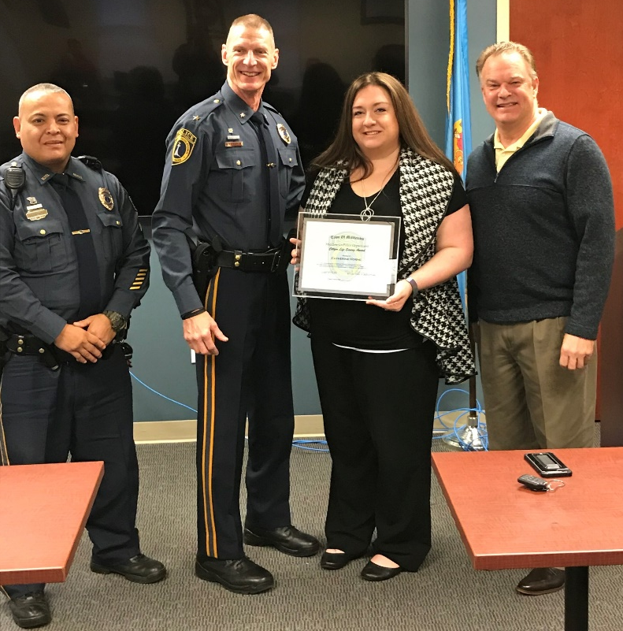
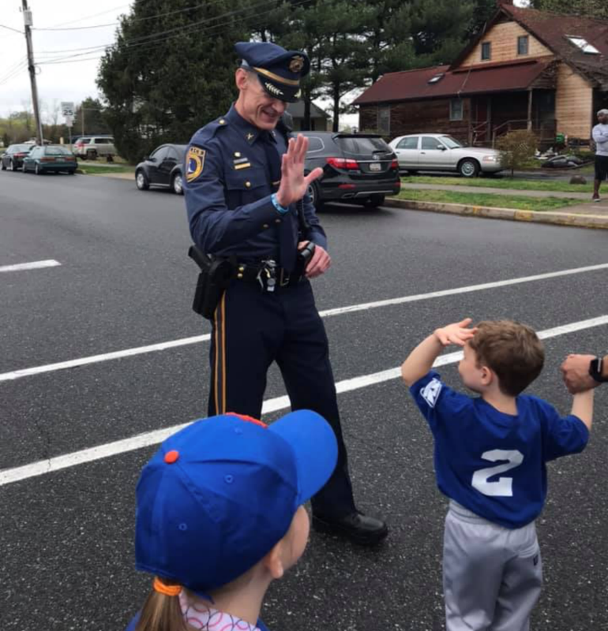
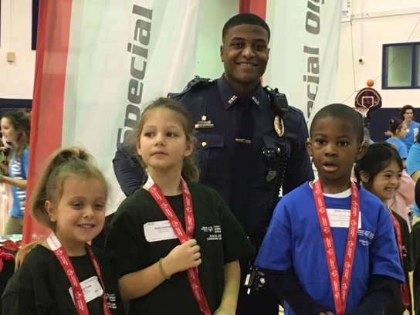
MISSION STATEMENT
To honorably serve the citizens of Middletown and its visitors using community oriented professional police services
CORE VALUES: I CARE
Integrity
Courage
Accountability
Respect
Empathy

Slide 6
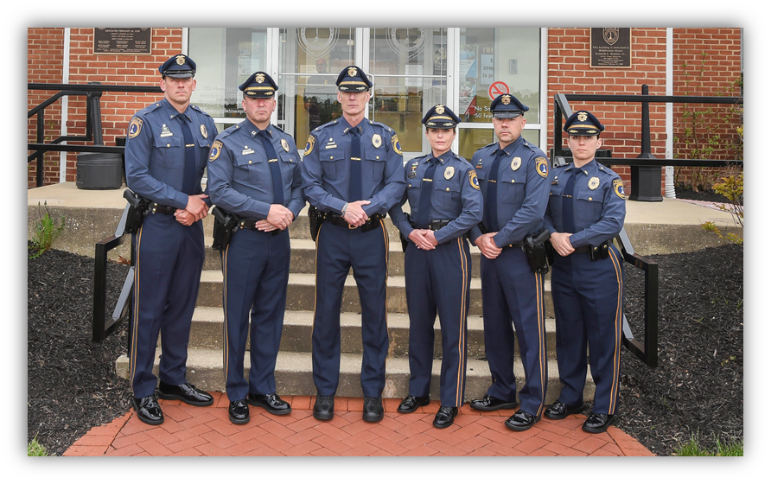
EXECUTIVE STAFF
The Executive Staff is overseen by the Chief of Police followed by the Captain. The Executive Staff is responsible for the operational components, personnel, administrative, budgetary, and personnel matters within the organization.
The Executive Division is staffed with an Executive Assistant and Command Staff Officers that oversee each operational division
From Left to Right: Lt. Fox, Capt. Texter, Chief Kracyla, Sr.Lt. Feldmann, Lt. Lancaster, Sr. Lt. Brenner

Slide 7
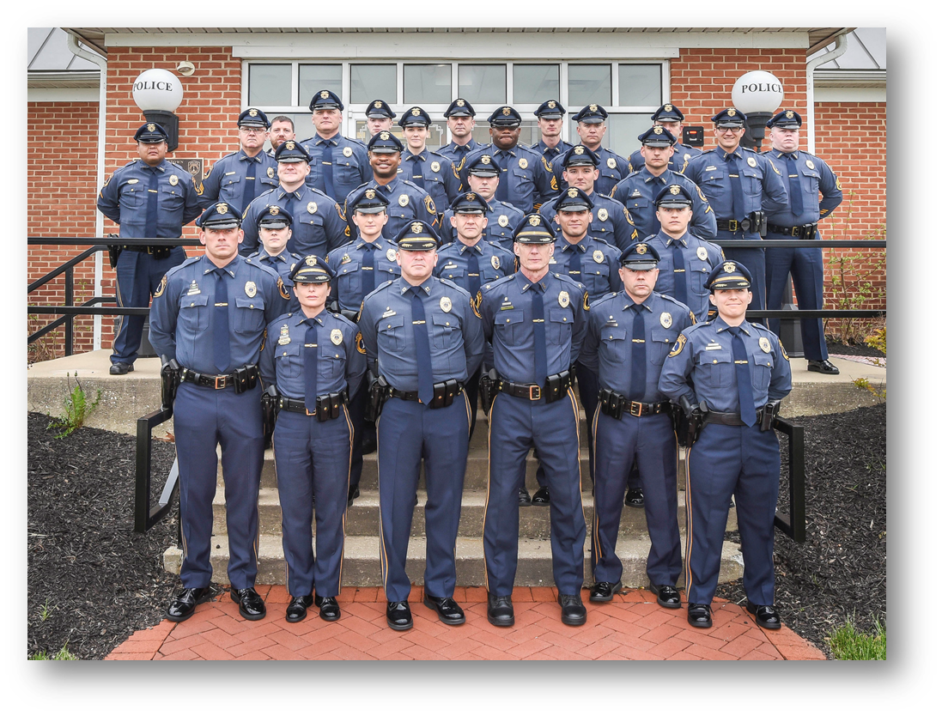
PATROL DIVISION
The Patrol Division is overseen by a Lieutenant and is responsible for all Field Operations. The Patrol Division is split into four squads, each being overseen by a Sergeant

Slide 8
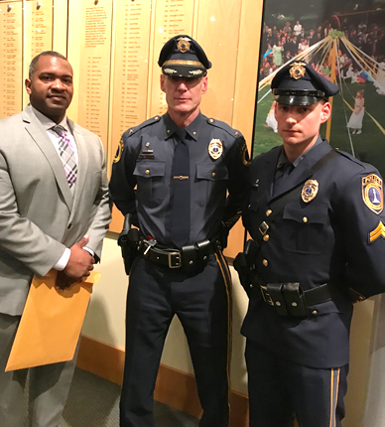
SIGNIFICANT EVENTS
Cpl. Hilliard and Off. Cole (pictured right with Chief Kracyla) were recognized by the New Castle County Emergency Medical Services Sudden Cardiac Arrest Survivors Night due to their life saving actions.
On Friday July 19th Officers responded to the area E. Hampstead Ct. regarding a suspicious vehicle complaint. A search of the vehicle revealed 56 grams of Marijuana and a Ruger 9mm handgun, that was reported stolen. $1700.00 was also seized from the defendants.
On Thursday December 12th Officers responded to the area of N. Cox St. reference a suspicious vehicle complaint. The vehicle, a silver Buick, was stopped and found to be occupied. A search of the vehicle found over 30 grams of PCP and drug paraphernalia. The driver was also found in possession of a switchblade knife. The driver was charged with several drug offenses and the weapon possession.

Slide 9
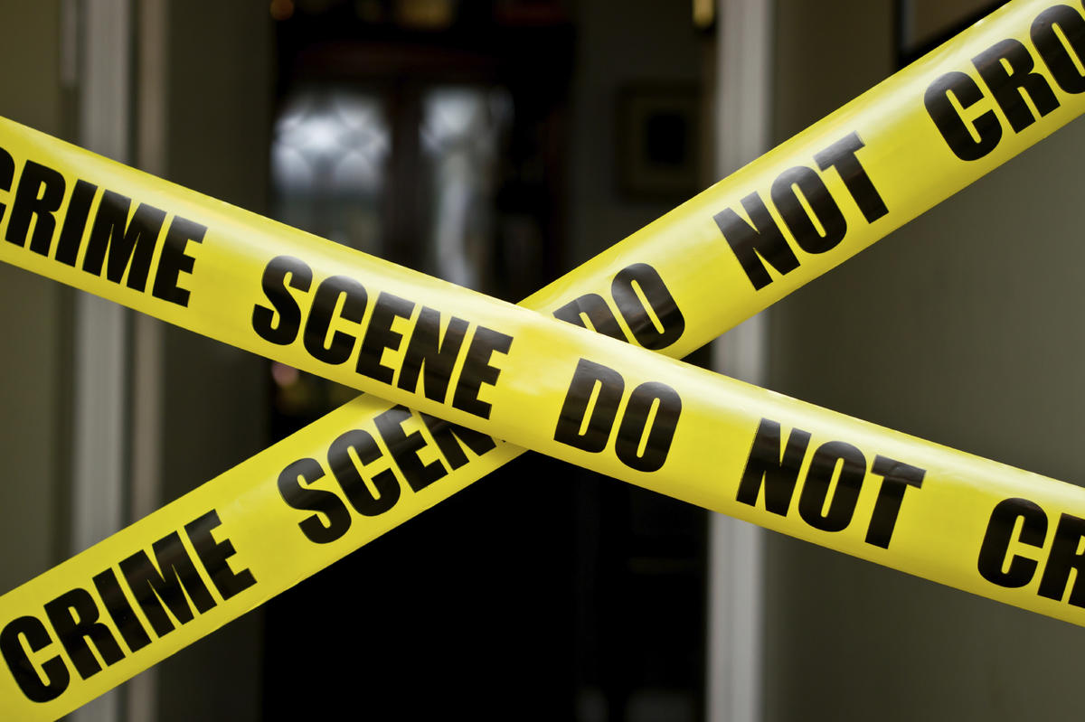
CRIMINAL INVESTIGATIVE DIVISION
The Criminal Investigative Division is overseen by a Lieutenant and is responsible for all forensic, special, and complex investigations. The Division is comprised of four general Detectives, one additional Detective assigned to the DEA Task Force, and a Crime Analyst.

Slide 10
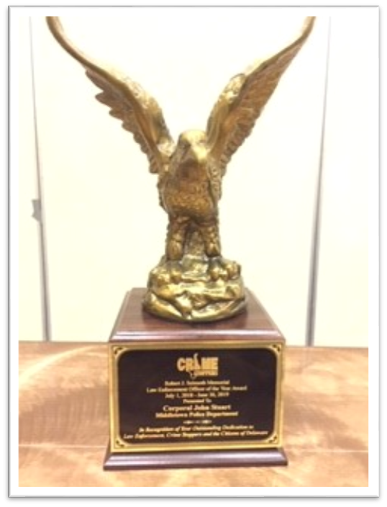
SIGNIFICANT EVENTS
Detectives learned that a 7 year old female informed her mother that her grandfather had been molesting her. The Reporting Person then questioned her other daughter (9 years old) who also disclosed sexual abuse spanning over several years. The Suspect was taken into custody and interviewed where he confessed to the sexual abuse of the children. He was charged with Rape 1st, Continuous Sexual Abuse of a Child (x3), Rape 2nd (x2), Unlawful Sexual Contact 1st (x4), and Sexual Abuse of a Child by a Person of Trust (x3)
Detectives were notified that a 4 month old victim was suffering from severe bruising to his ear, chin, and bite marks to several areas of his body. A skeletal examination revealed possible healing rib fractures. The suspect, who was the child's father was interviewed a re-enactment using a doll was conducted. The suspect eventually confessed to the abuse and was charged with Abuse 1st, Assault 2nd, and Endangering the Welfare of a Child
Detectives conducted a Death Investigation where the victim was found deceased from a drug overdose in the early morning hours in a parking lot off of Industrial Drive. Through their investigation, Detectives were able to identify the victim’s supplier. A search warrant was conducted on the suspect’s residence and the supplier was taken into custody
Det. Stuart was the lead investigator for DEA Group 42 whose long term investigation led to the arrest of two subjects that were charged in federal court in connection with sales of Fentanyl-laced fake Oxycodone pills in Delaware. One of the defendants as arrested after selling a kilogram of heroin and 600 fake Oxycodone pills containing Fentanyl. A Subsequent search warrant of that residence yielded approximately 7 additional kilograms of heroin; 3 kilograms of cocaine; 14,000 fake Oxycodone pills that tested positive for the presence of Fentanyl and over $28,000 in cash. Also seized were an additional 2 kilograms of heroin from a hidden compartment in one of the defendant’s vehicle. U.S Attorney Weiss noted that this was the largest federal seizure of heroin and fake Oxycodone pills by Delaware Law Enforcement in recent memory stating “thousands of fentanyl laced pills and over 1.4 million doses of heroin have been taken out of the hands of those who seek to profit from illegally distributing these poisons to our communities.” Two defendants were charged with distribution of fentanyl and face a maximum of 20 years in prison and a $1,000,000 fine.
Det. Stuart received the 2019 Crime Stoppers Officer of the Year Award

Slide 11
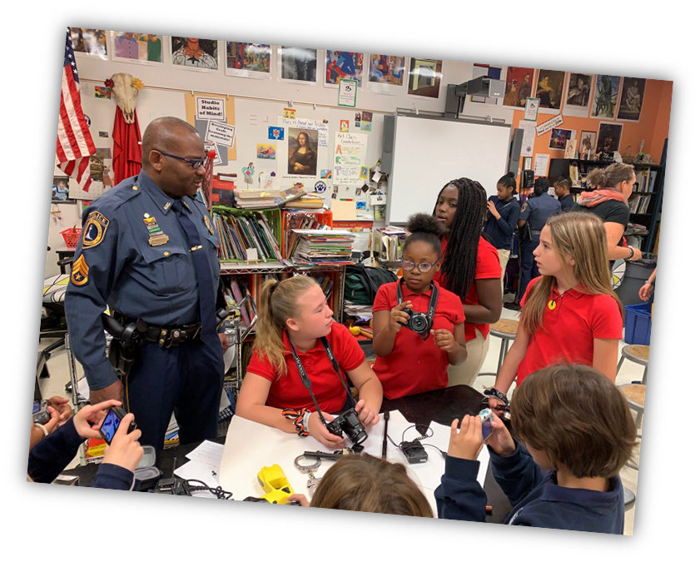
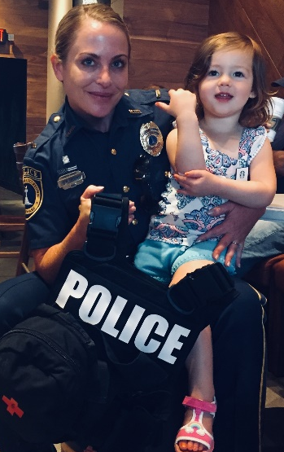
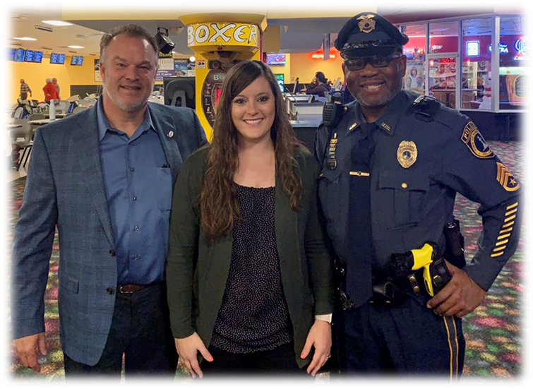
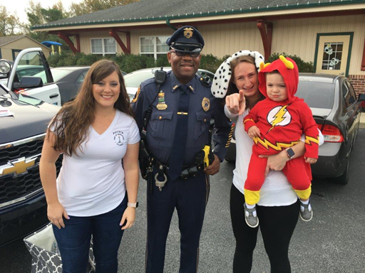
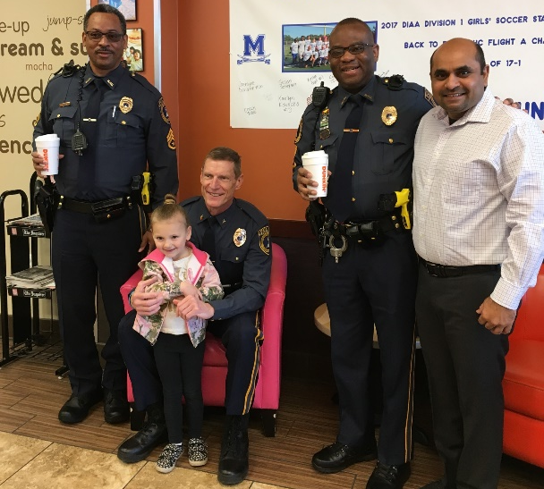
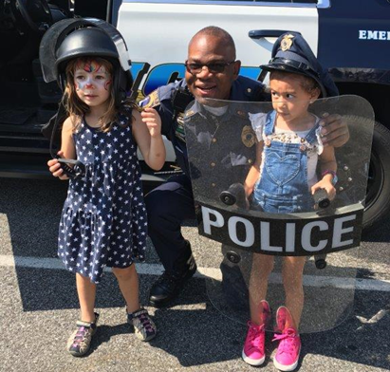
COMMUNITY SERVICES
The Community Services Division is overseen by a Lieutenant and is responsible for Community Outreach. This also includes the Citizen’s Police Academy, Youth Academy, Drug Take Back and Coffee with a Cop to name a few.
The Division is comprised of a Sergeant and an Administrative Assistant.

Slide 12
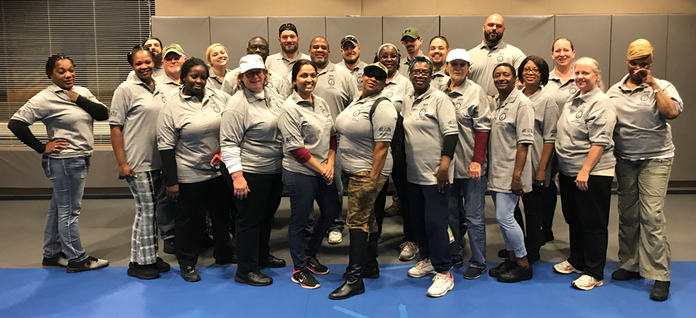
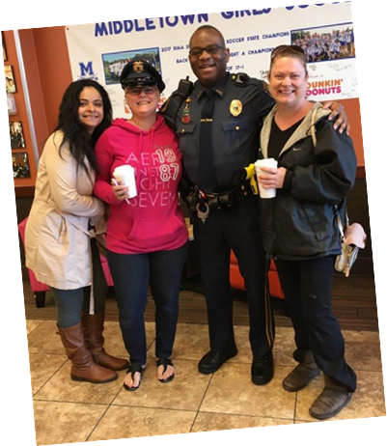
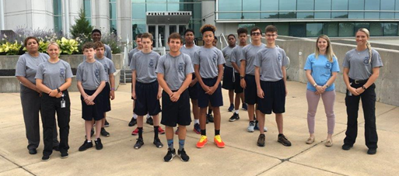
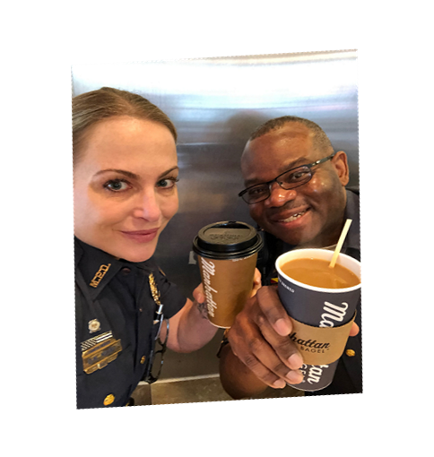
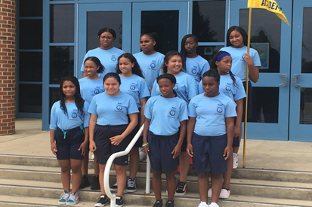
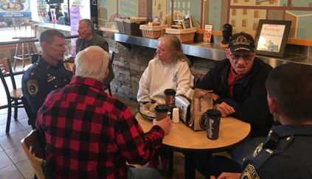
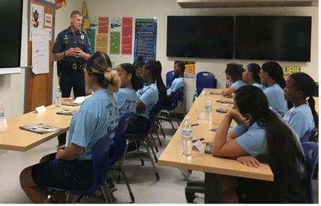
SIGNIFICANT EVENTS
Citizens Police Academy
Youth Academy
Coffee with a Cop

Slide 13
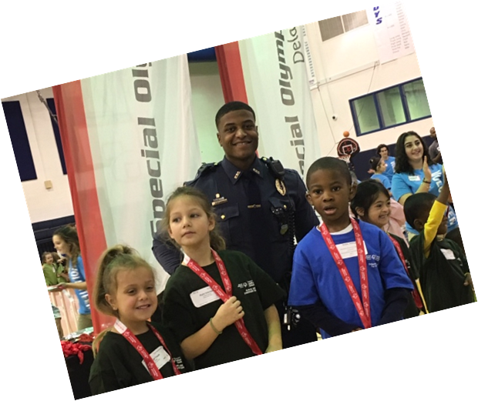
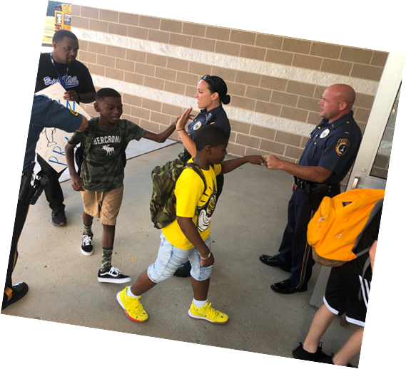
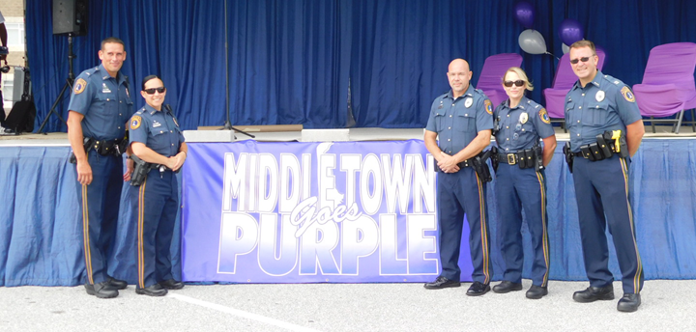
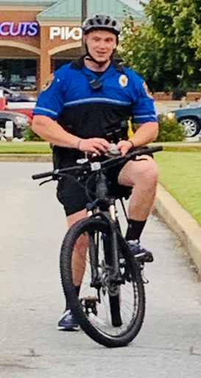
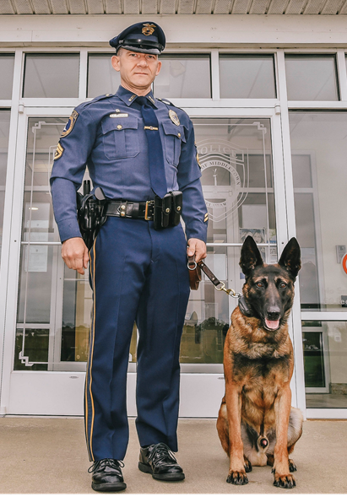
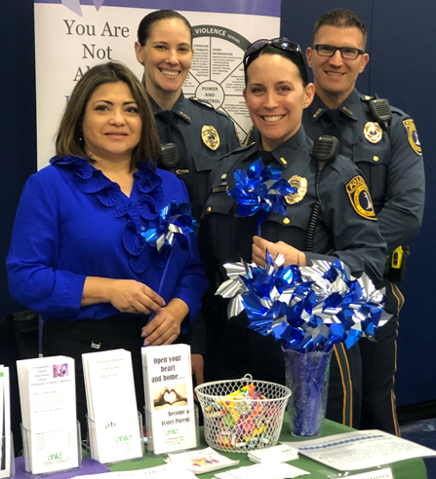
Special Olympics
Community Outreach
Middletown Goes Purple
Bike Patrol
Recruitment
K-9

Slide 14
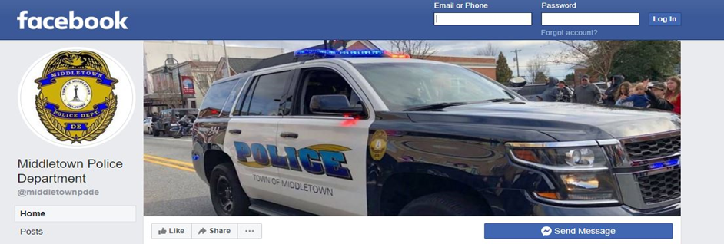
SOCIAL MEDIA
WEBSITE – https://Police.Middletown.Delaware.Gov
INSTAGRAM
1,637 Followers
FACEBOOK
8,960 Followers
There were 14 Attempt to Identify and Wanted posts throughout 2019.
Out of those 14 posts, 2 of them were identified or saw that they were wanted on Facebook and turned themselves in.

Slide 15
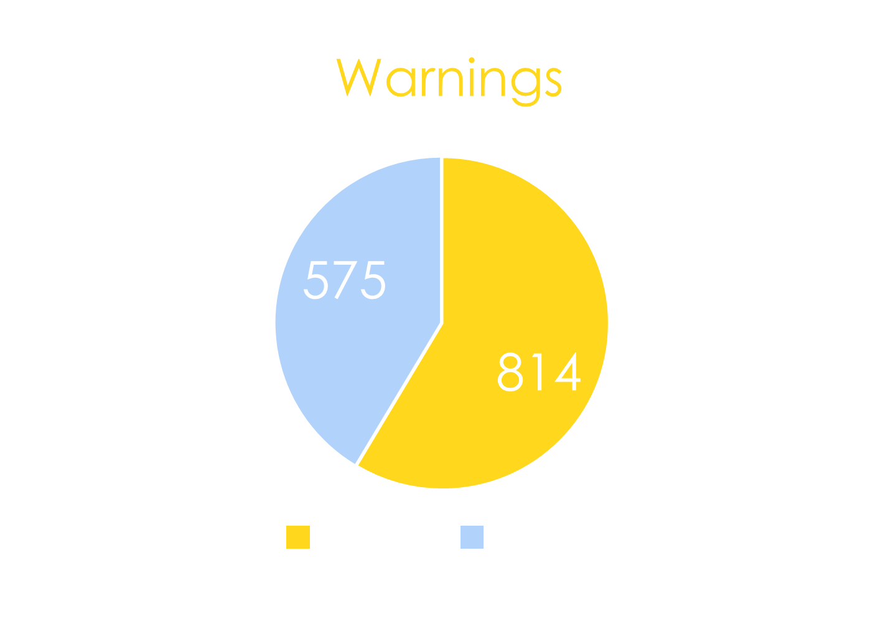
STATISTICS
E-Tickets increased 20 percent from 2018
E-Tickets/Summons
There was a 41 percent increase in Warnings from 2018
Warnings

Slide 16
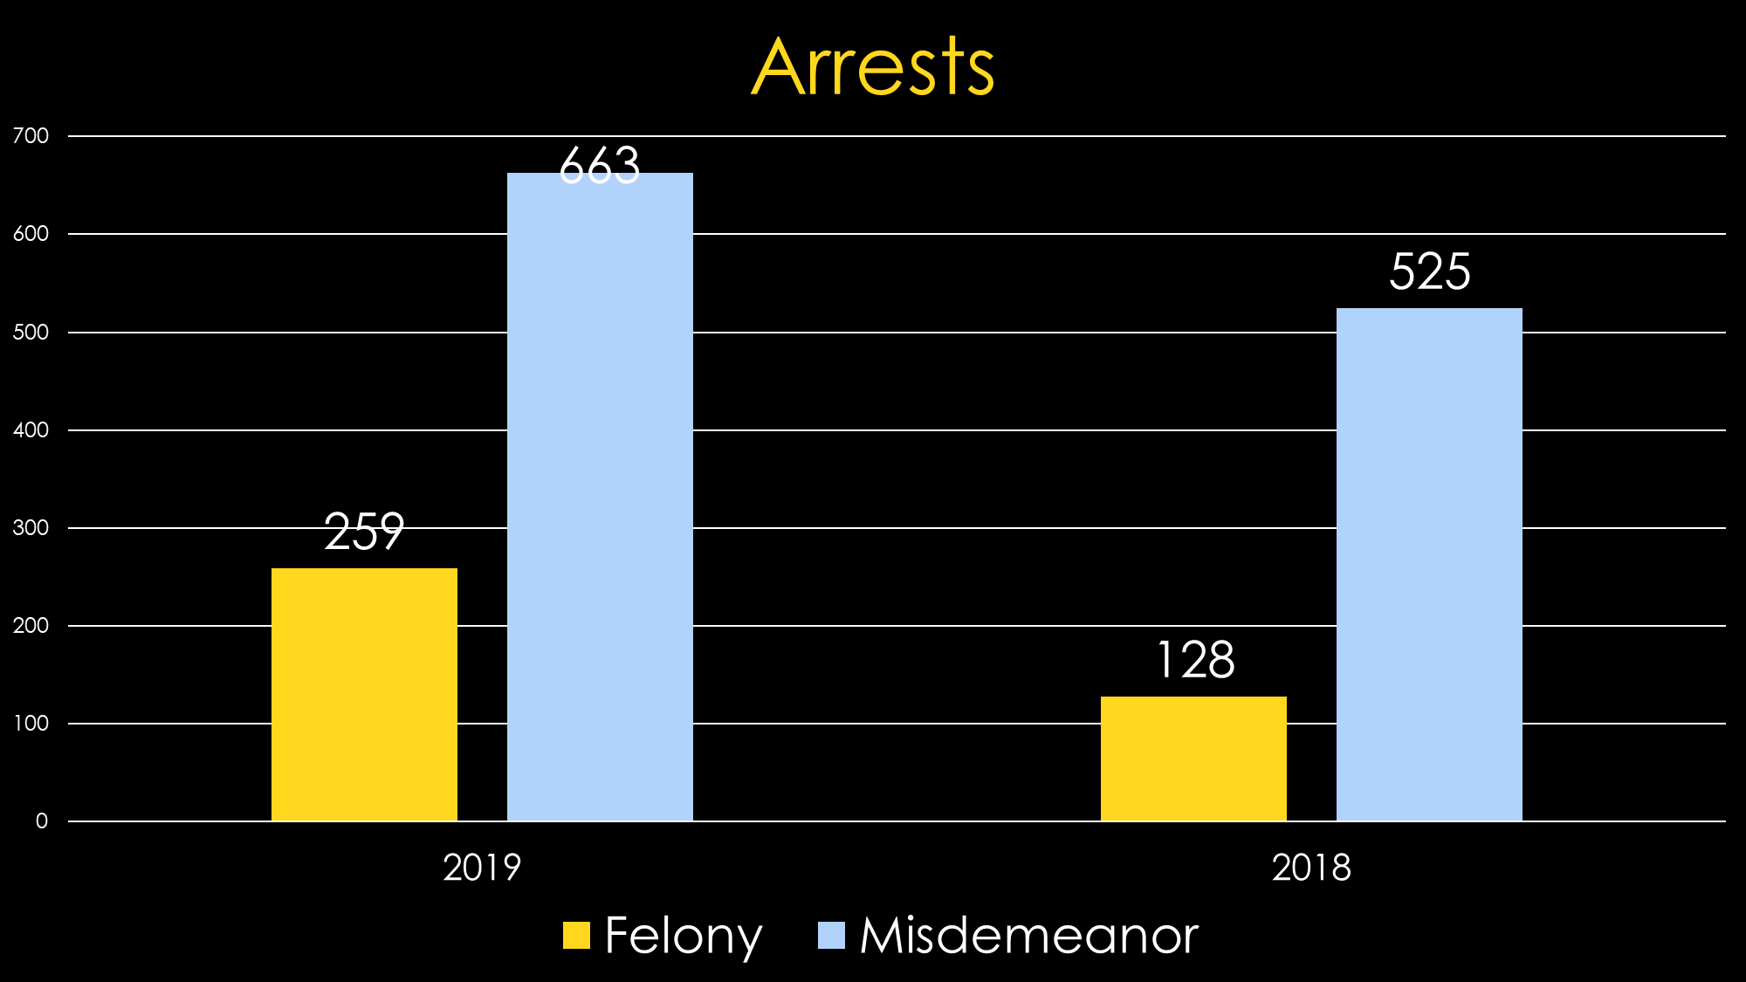
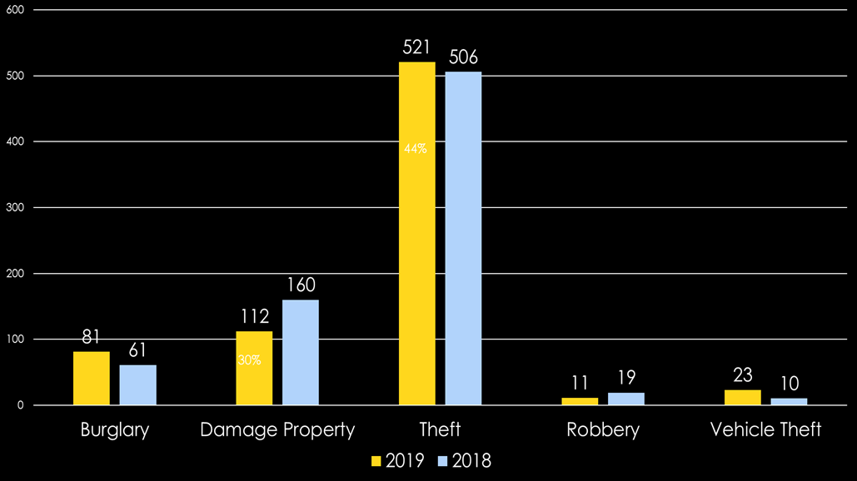
Arrests
There was a 32 percent increase in Burglary clearances from 2018
Crime Clearances

Slide 17
Reports
There was a 114 percent increase in FSR reports from 2018
There was a 16 percent decrease in Personal Injury accidents from 2018
Vehicle Crashes

Slide 18
MIDDLETOWN POLICE DEPARTMENT
130 Hampden Rd
Middletown, DE 19709
(302) 376-9950
https://Police.Middletown.Delaware.Gov

